Slide 1
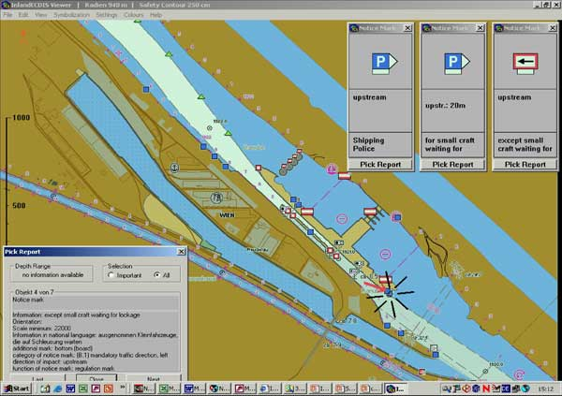

Inland ENC
Notes:
This presentation has been prepared by the Inland ENC Harmonization Group in order to explain the concept of Inland ENCs and the status of the Harmonization Group.

Slide 2
Content
Inland waterways
Why are ENCs not sufficient? (voyage planning)
Definition of Inland ENC
S-100 approach
New and copied features, attributes, enumerations
Encoding Guide for Inland ENCs
Usages and overlays
Product Specification for Inland ENCs
Depth data and water levels
IEHG and IHO
Regulatory status
Coverage
Users of Inland ENCs
Notes:
Before we talk about Inland ENCs I have to explain what we mean when we say “inland waterway”.
Then I have to clarify why Electronic Navigational Charts (ENCs) for maritime navigation are not sufficient for inland navigation.
This leads to the definition of an Inland ENC.
Then I will turn to the S-100 approach of IHO
and explain the use of copied features, attributes and enumerations in Inland ENCs.
I will present the Encoding Guide for Inland ENCs,
the different usages and the use of overlays,
the Product Specification for Inland ENCs,
and the information on depth data and water levels.
After the technical points I will turn to the organisational relation of the Inland ENC Harmonization Group (IEHG) and the International Hydrographic Organization (IHO).
And I will conclude my presentation with an overview on the regulatory status of Inland ENCs in the various regions,
the coverage of inland waterways with Inland ENCs,
and the number of users of Inland ENCs.

Slide 3
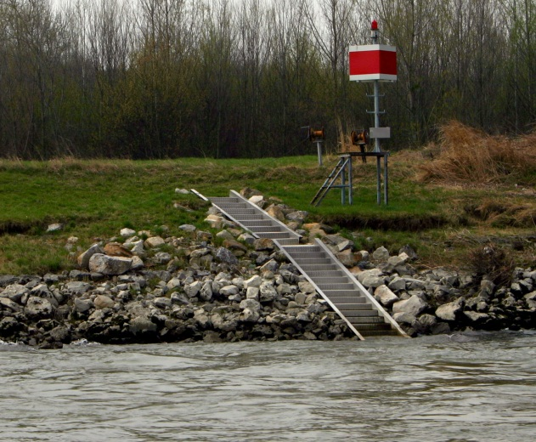

Inland waterways
Maritime navigation is governed by worldwide regulations of IMO, e.g. COLREG and SOLAS
Inland waterways (e.g. Mississippi,
Amazon, Rhine, Danube, Volga,
Yangtze, and all smaller navigable
rivers and lakes) have specific features
and specific regulations (specific
signals, markings, and traffic rules,
groins, groundsills, revetments, …)
The lower parts of the big inland waterways are used by both inland and maritime vessels
Inland ENCs need to meet the requirements of inland waterways, but should also be available for maritime vessels
Notes:
Now let’s start with the question what we mean when we are talking about “Inland”: maritime navigation is governed by worldwide regulations of the International Maritime Organization (IMO), for example the rules for collision prevention, COLREG.
On the other hand inland waterways like the Mississippi, the Amazon, the Rhine, the Danube, the Volga, the Yangtze and all the smaller navigable rivers and lakes have specific features like groins, groundsills and revetments and specific regulations with specific signals, markings and traffic rules. (The picture is showing an example of a sign on the Danube which is indicating that the navigational channel is near the right bank)
The lower parts of the big inland waterways are not only used by inland vessels, but also by maritime vessels.
Therefore Electronic Navigational Charts for inland waterways (Inland ENCs) have to cover the specific needs of inland waterways, but should also be available for maritime vessels.

Slide 4
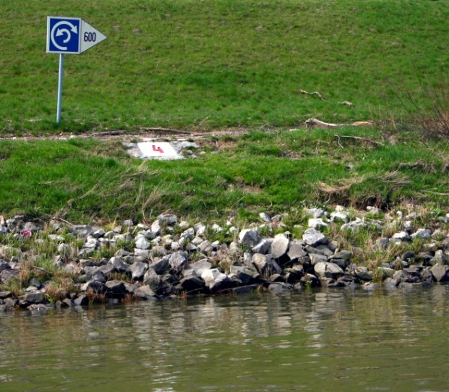
The need for Inland ENCs
Waterborne traffic on inland waterways is not regulated by COLREG or SOLAS, but by regional or national regulations:
  Europe: European Code for Inland Waterways (CEVNI) of the United Nations
  USA: Code of Fed. Regulations 33 CFR
  Russia: Rules of navigation along
  the inland waterways of RF
  China and Brazil: a set of national
  and regional regulations
  South Korea and Venezuela:
  national regulations
These regulations contain specific
waterway signals, signs and markings
Notes:
The easiest solution to ensure full compatibility with maritime Electronic Chart Display and Information Systems (ECDIS) would be to use the worldwide maritime standards for Electronic Navigational Charts (ENCs). But that’s not possible: traffic on inland waterways is not regulated by the maritime Collision Prevention Rules (COLREG), but by regional regulations.
The regulations for the European waterways are based on the “European Code for Inland Waterways” (CEVNI) of the Economic Commission for Europe of the United Nations.
The US inland waterways are governed by the Code of Federal Regulations 33 CFR.
On the Russian inland waterways there are the Rules for Navigation along the inland waterways of the Russian Federation.
Brazil has a set of national and regional regulations for its inland waterways.
The Peoples Republic of China has …
And the Republic of Korea is using …
All these different regulations are containing specific waterway signals, signs and markings. (The picture is showing a notice mark on a European waterway, which is indicating a section of river which is wide enough to turn a vessel. You do not have such a sign in maritime navigation, but it is very important for a skipper on an inland vessel.)

Slide 5
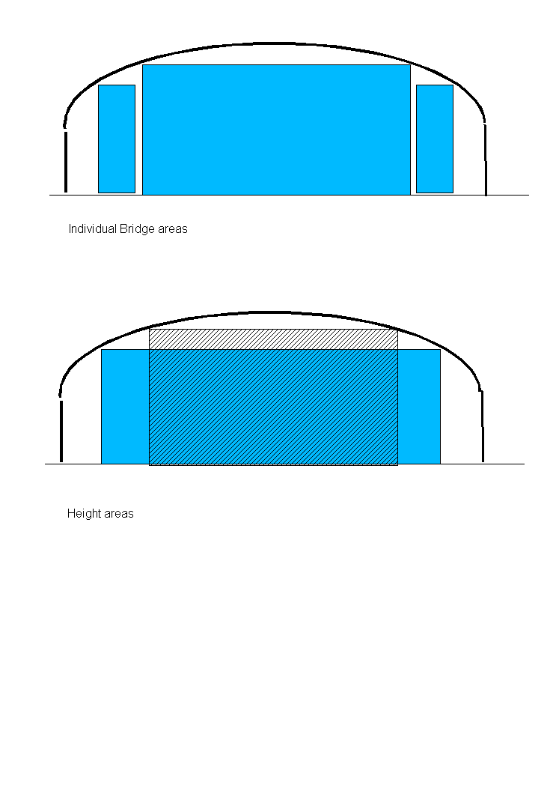
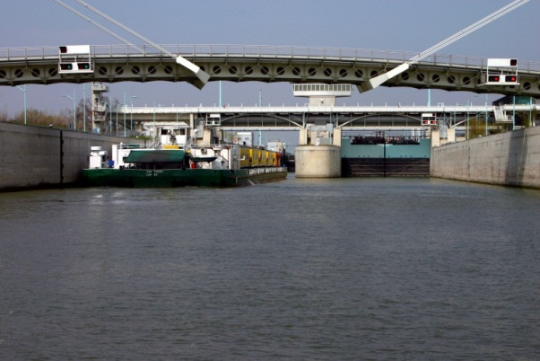
Why Inland ENCs?
Objects such as bridges can only be encoded in a very basic form for maritime ENCs, but are extremely important for inland navigation
In inland navigation it is normally not possible to take another route, if there is a problem on the original route: detailed information is critical for voyage planning (e.g. dimensions and operating hours of locks and movable bridges)
Notes:
In the maritime ENCs which are based on the S-57 standard of the International Hydrographic Organization (IHO) bridges can only be encoded in a very basic form. But detailed information about bridges is extremely important for inland navigation. Normally it is not possible to take another route, if a bridge is to low. Many bridges have arches, but in accordance with the maritime standards the ENC would only provide one value for the vertical clearance above the channel. In an Inland ENC you can provide more detailed information that is providing the possible combinations of width and height for a safe passage under the bridge.
But this is just one example. The dimensions and the operating hours of locks and movable bridges are other examples of information which is critical for voyage planning on an inland waterway. Maritime ENCs are not able to provide this information in a machine readable form, so that it can be used in voyage planning systems.
Therefore it was necessary to develop an Inland ENC.

Slide 6
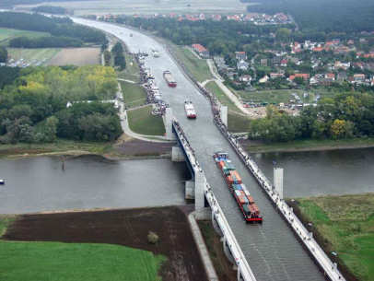
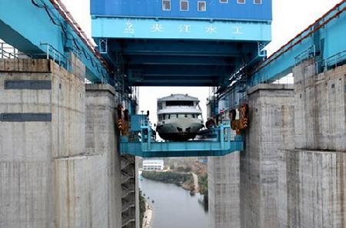
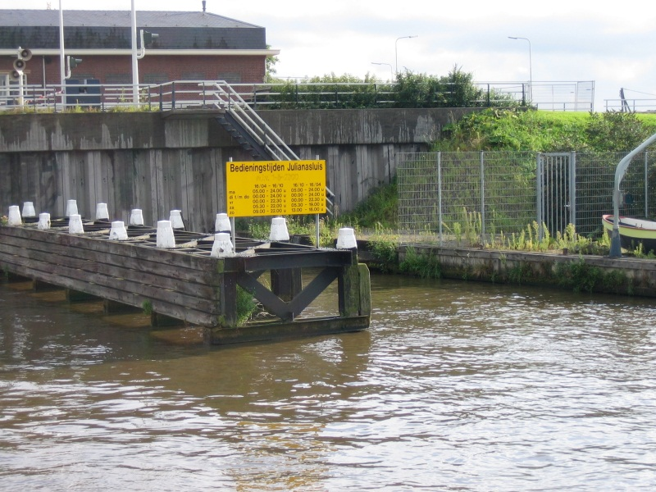
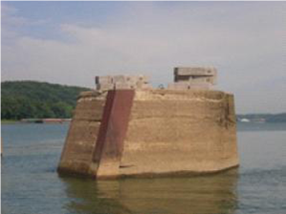
Why Inland ENCs?

Slide 7
Definition of Inland ENC
the database, standardized as to content, structure and format, for use with inland electronic chart display and / or information systems operated onboard of vessels transiting inland waterways. An IENC is issued by or on the authority of a competent government agency, and conforms to standards initially developed by the International Hydrographic Organization (IHO) and refined by the Inland ENC Harmonization Group. An IENC contains all the chart information necessary for safe navigation on inland waterways and may contain supplementary information in addition to that contained in the paper chart (e.g. sailing directions, machine-readable operating schedules, etc.) which may be considered necessary for safe navigation and voyage planning. [IENC Encoding Guide, Edition 2.2, Feb 2010]
Notes:
Here you can see the official definition of an Inland ENC: An Inland ENC is the database, standardized as to content, structure and format, for use with inland electronic chart display and / or information systems operated onboard of vessels transiting inland waterways. An IENC is issued by or on the authority of a competent government agency, and conforms to standards [initially] developed by the International Hydrographic Organization (IHO) and [refined by] the Inland ENC Harmonization Group. An IENC contains all the chart information necessary for safe navigation on inland waterways and may contain supplementary information in addition to that contained in the paper chart (e.g. sailing directions, machine-readable operating schedules, etc.) which may be considered necessary for safe navigation and voyage planning. [IENC Encoding Guide, Edition 2.2, Feb 2010]
But how can we reach this goal and ensure compatibility with maritime ENCs at the same time?

Slide 8
The S-57 → S-100 approach
Inland ENCs are similar to ‘maritime’ ENCs, with a few exceptions:
  Use of S-57 object classes, attributes and attribute values, as much as possible
  Introduce new combinations of existing elements, when necessary
  Include new features, attributes or enumerations, if necessary
Prior to the adoption of S-100, it was necessary to assign small case acronyms for S-57 object classes that were used with additional or new attributes/enumerations and for new elements
Small case elements have been replaced by elements from the HYDRO and the IENC domains in the S-401 Product Specification, which is based on S-101
Notes:
Inland ENCs are based on a concept which is very similar to S-100 of IHO:
We use S-57 (edition 3.1) object classes, attributes and attribute values as far as possible.
We introduce new combinations of existing elements if necessary and
We introduce new object classes, attributes or enumerations if necessary.
But when we started with the development of Inland ENCs, S-100 was not available. Therefore it was necessary to assign new small case acronyms for object classes that were used with additional or new attributes and/or enumerations and for new elements. These small case elements will be replaced by elements from the HYDRO and the IENC domains in the future.

Slide 9
Copied and new elements
The S-57 attribute VERDAT (vertical datum) only contains enumerations for vertical datums for maritime navigation
In inland navigation there are different vertical datums in use (e.g. Ohio River Datum, Russian Project Water Level, Reference Low water Level of Danube Commission, etc.)
Inland ENCs contain a copied attribute “verdat” with these additional enumerations
With this copied attribute it is also necessary to introduce a copied feature “m_sdat”
For some features that are not covered by S-57 it was necessary to introduce new features (e.g. notice marks)
Features
Attributes
Enumerations
Notes:
Let me present some examples:
The maritime S-57 attribute Vertical Datum (VERDAT) is containing oly enumerations for vertical datums that are used in maritime navigation.
In inland navigation there are different vertical datums in use, for example the Ohio River Datum, the Russian Project Water Level, the Reference Low Water Level of the Danube Commission and so on.
Therefore Inland ENCs contain the copied attribute “verdat” (with a small case letter acronym) with these additional enumerations.
Because we are using a copied attribute instead of an S-57 attribute we had to introduce a copied object class “m_sdat” (meta sounding datum).
And then there are some features that are not covered by S-57, as for example notice marks on the shoreline. It was necessary to introduce new features (also with small case acronyms).
If you want we can have a look at the lists of features, attributes and enumerations of Inland ENCs.

Slide 10
Encoding Guide for Inland ENCs
To ensure a common understanding and consistent encoding for all worldwide regions, there is a very detailed Encoding Guide for Inland ENCs (which replaces the section “Use of the Object Catalogue” of S-57)
See following example for the encoding of a bridge with bridge arches:
Notes:
The most important tool of the harmonization process is the Encoding Guide for Inland ENCs. It ensures a common understanding and the same encoding in different areas. This Encoding Guide replaces the section “Use of the object catalogue” of the S-57 standard.
Here is an example:

Slide 11
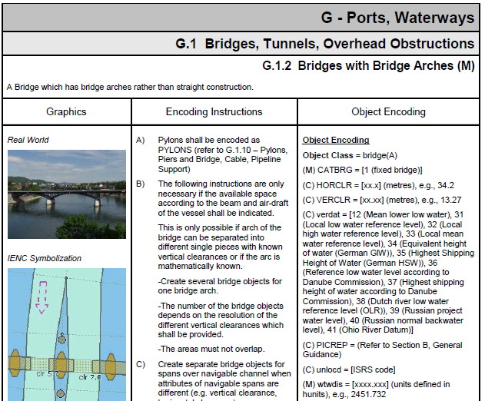
Notes:
As you can see, the Encoding Guide contains rules for the encoding of real world objects, as for example bridges with bridge arches. It provides a description and a picture of the real world object to prevent misinterpretations. It provides a picture of the correct display in an Inland ENC and detailed Coding Instructions. The third column is listing the objects, attributes and attribute values that have to be used to encode this object.
The already existing Encoding Guide of the USACE was used as a basis and the European partners used the template to explain their way of encoding. Then we discussed the different approaches and agreed on a common approach. The same method was used later for the Russian and Brazilian Inland ENCs. The harmonized Encoding Guide is now the basis for chart production in all these regions.

Slide 12
Usages
On major inland waterways, Inland ENCs are normally produced and used at a larger scale than ‘maritime’ ENCs
While the largest scale for ‘maritime’ ENCs is usage 6 (berthing), for Inland ENCs there are three usage codes:
7 - river
8 - river harbour
9 - river berthing
Notes:
Another difference between maritime S-57 ENCs and Inland ENCs are the “usages”. S-57 is defining 6 usages ranging from overview to berthing. But Inland ENCs are normally used in bigger scales then the S-57 ENCs for usage 6, berthing. Therefore we have introduced additional usages
7 – river
8 – river harbour and
9 – river berthing

Slide 13
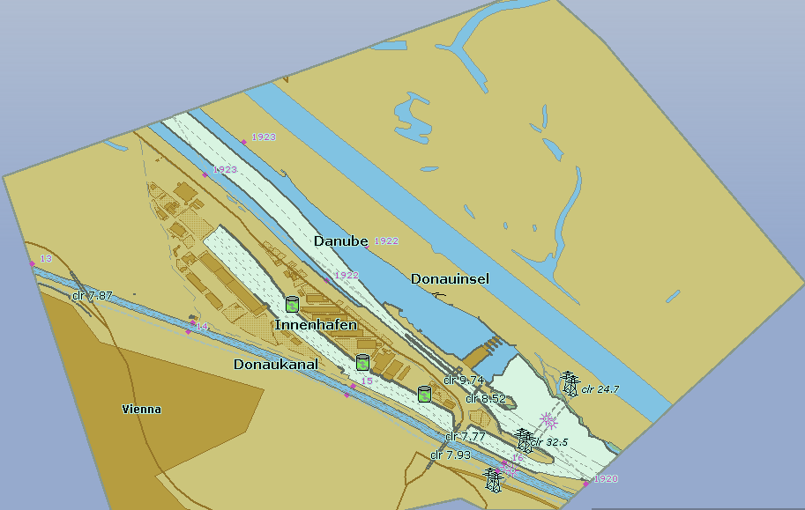
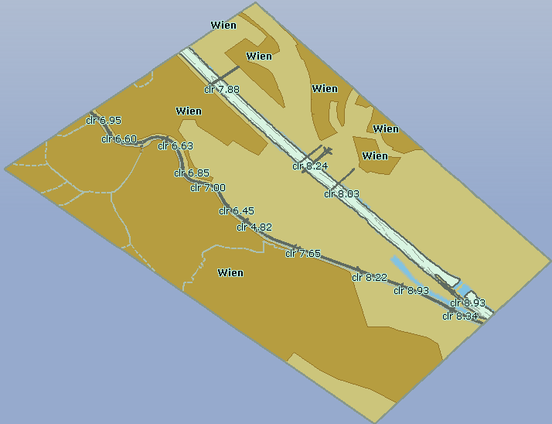
Usages
Usage 8
Usage 7
Notes:
Another difference between maritime S-57 ENCs and Inland ENCs are the “usages”. S-57 is defining 6 usages ranging from overview to berthing. But Inland ENCs are normally used in bigger scales then the S-57 ENCs for usage 6, berthing. Therefore we have introduced additional usages
7 – river
8 – river harbour and
9 – river berthing

Slide 14
Overlay cells
In some regions, different authorities are responsible for the maintenance of the waterway, and for the traffic regulation (e.g. buoys, beacons, notice marks, signals)
Depth information is extremely important on inland waterways (50 cm between keel and riverbed is normal) and in some areas depth are constantly changing
As such, it may be necessary to update the depth information much more frequently then the rest of the Inland ENC
Inland ENCs provide the possibility to use “overlay cells”
Notes:
While the Hydrographic Offices are the only official chart producers in the maritime world, there are some areas in inland navigation, where different authorities are responsible for the maintenance of the waterway (including the related chart production) and for traffic regulations (including the information on buoys, beacons, notice marks, signals, restricted areas and so on). This was the first reason to develop overlay cells.
But there is another important reason: depth information is extremely important on inland waterways. An under keel clearance of 50 cm is normal. But there are areas where the depth is changing rapidly. It is therefore necessary to update the depth information much more frequently than the rest of the information in an Inland ENC.
The overlay concept allows to provide an cell, which is only containing updated depth information. (all objects that are situated within the waterway, e.g. buoys or bridges, have to be placed in an overlay cell and are therefore not “covered” by the depth-cell, but shown on top of the updated depth information.)

Slide 15
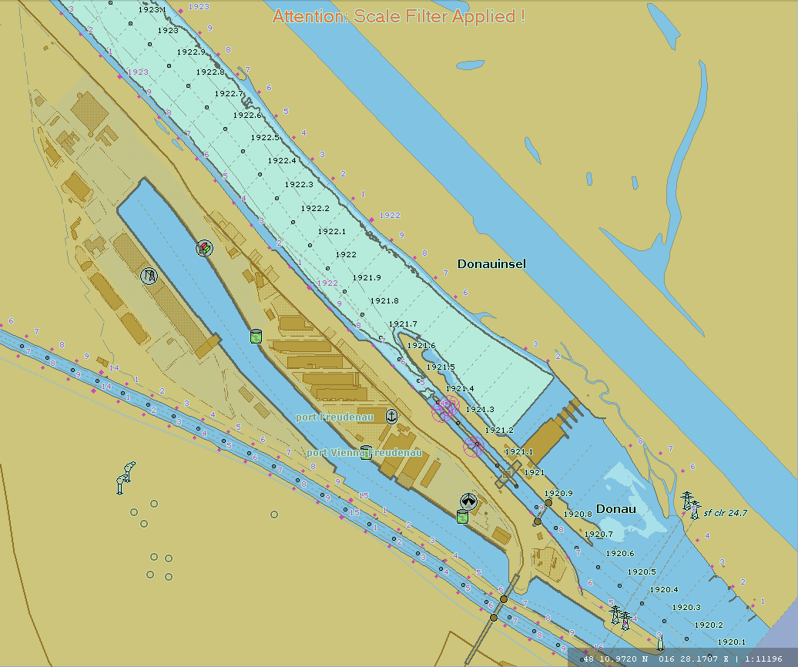
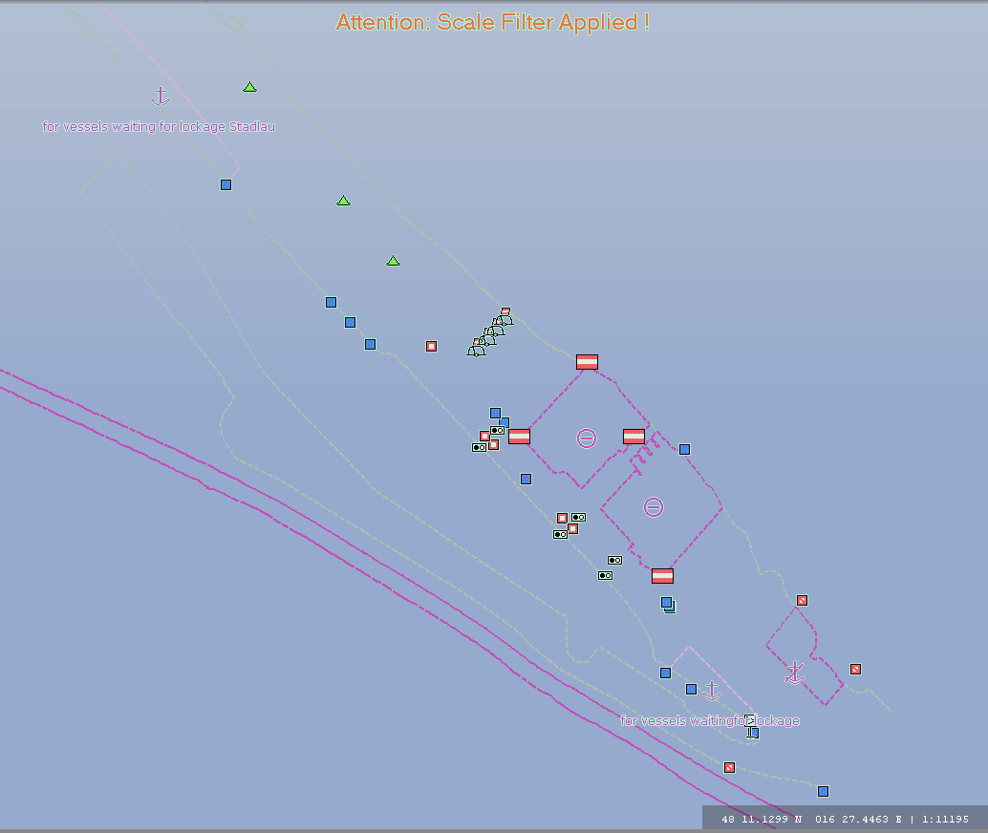
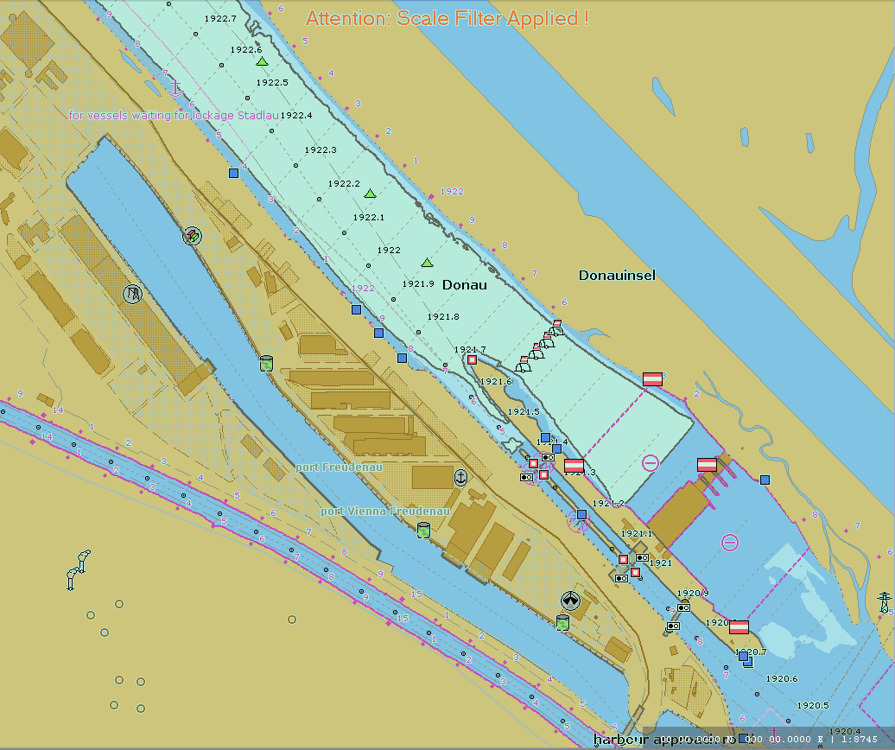
Overlay cells
Overlay cells do not contain skin of the earth features
They are displayed by an Inland ECDIS together with an Inland ENC of usage 1 to 9
The Inland ECDIS uses the display priorities to compose the display
Producers have to agree on which non-skin of the earth objects are encoded in which layer
+ =
Notes:
How does this work?
Overlay cells may not contain “skin of the earth objects”. (All skin of the earth objects have to be in the base cell.)
The overlay cells are displayed together with Inland ENCs of usage 1 to 9.
The application uses the display priorities to compose the display in the correct way.
In this example here you can see an Inland ENC which is containing all the topographic information. The overlay cell is containing all the information which is related to traffic regulations (buoys, beacons, notice marks, restricted areas). The two layers are combined to one image which is containing all the information. The user does not see any difference compared to a picture which is derived from a single ENC.

Slide 16
Product Specification for Inland ENCs
The Product Specification for Inland ENCs is based on IHO
S-57, edition 3.1
It contains the necessary amendments to enable the encoding of additional features for inland waterways
It describes the differences (e.g. in the cell header) that identify the cell as an Inland ENC, the usage, and so on
The Product Specification is comprised of the Feature Catalogue and the Encoding Guide for Inland ENCs
Notes:
You have seen now, why maritime ENCs are not sufficient for inland waterways and you have seen the main differences between Inland ENCs and maritime ENCs. The result of this development is a Product Specification for Inland ENCs, which is based on the S-57 Product Specification of IHO.
This Product Specification for Inland ENCs contains the necessary amendments to enable the encoding of the additional features for inland waterways.
It describes the differences, for example in the cell header, that identify the cell as an Inland ENC, the usage, and so on.
( the Product Specification is containing the Feature Catalogue for Inland ENCs and the Encoding Guide for Inland ENCs)

Slide 17
Depth data and water levels
Depth data in ENCs is based on a vertical datum, which is a horizontal plane
Depth data in Inland ENCs of rivers is referred to sloped and non-linear reference water level
The actual water level is irregular and can not be determined by tide tables. Instead, it has to be derived from water level gauges
Due to variations of the area of cross sections and the base slope of the riverbed different water levels are not parallel to one another
Water level models are needed to calculate the actual depth at a specific point of the waterway at a specific moment
Notes:
Let me present the latest development regarding depth data and water level information, which is partly outside the Product Specification:
Depth data in Inland ENCs is not referred to a horizontal reference level, but to a sloped and non-linear reference water level ( as for example the “reference low water level” as defined by the Danube Commission).
The actual water level can not be determined by tide tables, but is completely irregular and has to be derived from gauges.
Due to variations in the cross sections and the slope of the bottom of a river and dynamic influences different water levels are not parallel to one another.
Therefore we need sophisticated water level models to calculate the actual water level and the actual depth at a specific point of the waterway at a specific moment.

Slide 18
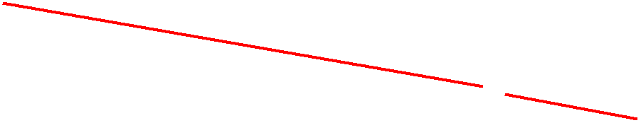
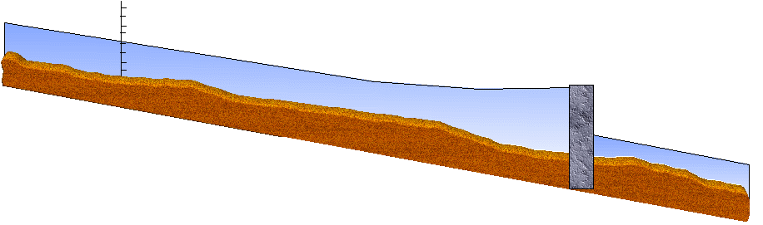
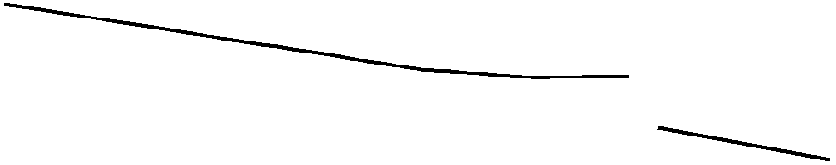

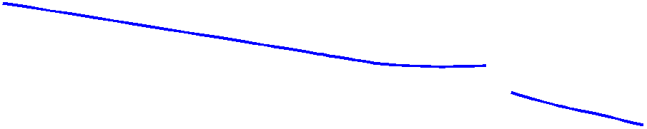
Depth data and water levels
A standardized data exchange format is available to transmit the results derived from water level gauge readings and water level models to the on-board applications
This information can be used to display the actual water depth in the Inland ECDIS without changing the Inland ENC
Notes:
There are so many different water level models and these models have so many different input values (including for example the throughput of the turbines of hydroelectric power stations and the positions of weirs, the amount of rainfall in a specific area, and so on) that it is not possible to include all these models in the on-board applications.
Therefore we have developed a standardized data exchange format to transmit the results which are derived from the water level models (on land) to the on-board applications.
This information can then be used to display the actual water depth in the Electronic Chart Display and Information System (Inland ECDIS or Inland ECS) without changing the Inland ENC itself.

Slide 19
The Inland ENC Harmonization Group
Objective: to develop and to maintain a harmonized standard for Inland Electronic Navigational Charts (IENCs) suitable for inland navigation that is based on the standards of IHO for ‘maritime’ ENC
Guiding principle: to agree upon specifications for Inland ENCs that are suitable for all known inland ENC data requirements for safe and efficient navigation on inland waterways.
Notes:
Now let me introduce the Inland ENC Harmonization Group (IEHG):
The Objective of IEHG is to develop and to maintain a harmonized standard for Inland Electronic Navigational Charts (IENCs) suitable for inland navigation that is based on the standards of IHO for ‘maritime’ ENC
The Goal is to agree upon specifications for Inland ENCs that are suitable for all known inland ENC data requirements for safe and efficient navigation. At the moment all European countries with a connected inland waterway network, the Russian Federation, the United States of America, Brazil, the Peoples Republic of China and the Republic of Korea are actively participating in IEHG.
It is further intended that IENC standards meet the basic needs for Inland ENC applications, worldwide.

Slide 20
IEHG - recognition
As the competent international technical group on Inland ENC technical standards development, implementation and maintenance, IEHG is recognized by:
    Europe - European Union and the Central Commission for Navigation on the Rhine
    North America – US Army Corps of Engineers
    Russian Federation - Russian Ministry of Transport
    Brazil, Peru and Venezuela – Hydrography and Navigation Services
    Asia – Transport Research Institute of the Ministry of Transport of PRC and KHOA of Republic of Korea
    International Hydrographic Organization (IHO)
Because there are several countries with Inland Navigation that are not Member States of IHO, IEHG does not intend to become a member of IHO.
Instead, IEHG supports, advises and provides input to IHO regarding Inland ENC matters as a recognized NGIO.
Notes:
IEHG is not an international organization like IHO, but it is recognized by
The European Union, the Central Commission for Navigation on the Rhine (CCNR),
The US Army Corps of Engineers,
The Russian Ministry of Transport,
The Directorates and Services for Hydrography and Navigation of the Brazilian Navy, Peru and Venezuela
The Ministry of Transport of the Peoples Republic of China, the Korean Hydrographic and Oceanographic Administration and
the International Hydrographic Organization (IHO).
Since there are several countries with Inland Navigation that are not Member States of IHO, IEHG does not intend to become a member of IHO.
Instead, IEHG supports, advises and provides input to IHO regarding Inland ENC matters.

Slide 21
IEHG – recognition (continued)
In 2009, IEHG has been recognized by IHO as a Non Governmental International Organization (NGIO) with observer status
Current members of IEHG are all European countries with connected inland waterways (17), Russian Federation, USA, Brazil, China, Republic of Korea, Peru and Venezuela
Notes:
IEHG has been recognized by IHO as a Non Governmental International Organization (NGIO) with observer status in 2009.
Current members of IEHG are the European countries with a connected inland waterway network, the Russian Federation, the United States of America, Brazil, the Peoples Republic of China, the Republic of Korea, Peru and Venezuela. But of course IEHG welcomes every country with inland waterways.

Slide 22
Regulatory status of Inland ENCs in Europe
The European Inland ECDIS Standard (includes the Inland ENC Product Specification and a performance and test standard for Inland ECDIS applications), has been adopted by
  the United Nations www.unece.org (2016, edition 2.4)
  the Central Commission for Navigation on the Rhine
  www.ccr-zkr.org (2006, edition 2.3)
  the Danube Commission www.danubecommission.org (2008)
  the European Union http://eur-lex.europa.eu/ (2018, edition 2.4)
  Member states of the European Union are obliged to provide a complete coverage of the bigger waterways (class Va and above) within 30 months after the publication of the standard
Notes:
IEHG is not able to make binding standards. Instead it is transmitting its proposals to international and national organizations for formalization. So let me give you a short overview on the regulatory status of Inland ENCs in the various regions.
The European Inland ECDIS Standard, which is containing the Product Specification for Inland ENCs and a performance and test standard for Inland ECDIS applications, has been adopted by
the Economic Commission for Europe of the United Nations, www.unece.org
the Central Commission for Navigation on the Rhine, www.ccr-zkr.org
the Danube Commission, www.danubecommission.org and
the European Union (publication pending)
Member states of the European Union will be obliged to provide a complete coverage of the bigger waterways (class Va and above) within 30 months after the publication of the standard.

Slide 23
Regulatory status of Inland ENCs
USA: The US Army Corps of Engineers (USACE) is responsible for the production and provision of Inland ENCs
Russian Federation: Federal task program on GLONASS development (Government regulation No. 587) includes the production of Inland ENCs for the inland waterways of Russian Federation (48000 km)
Brazil: The Directorate for Hydrography of the Brazilian Navy (DHN) is responsible for the production and provision of Inland ENCs
Notes:
In the USA the US Army Corps of Engineers (USACE) is responsible for the production and provision of Inland ENCs.
In the Russian Federation the Federal task program on GLONASS development (Government regulation No. 587) includes the production of Inland ENCs for the inland waterways of Russian Federation (48000 km).
In Brazil the Directorate for Hydrography of the Brazilian Navy (DHN) is responsible for the production and provision of Inland ENCs.

Slide 24
Coverage of Inland ENCs
USA: 20 inland waterways with 11 265 km have been covered with Inland ENCs
Russian Federation: 26 000 km of RF inland waterways have been covered with Inland ENCs
Brazil: DHN is capturing data for the production of Inland ENCs for approximately 4000 km of inland waterways
Europe: 10 250 km of inland waterways have been covered with inland ENCs
For more details see http://ienc.openecdis.org/files/IENC_Prod_overview.pdf
Notes:
So we have a satisfying regulatory basis for Inland ENCs in most regions. The next questions is, how many Inland ENCs have already been produced?
In the USA 20 inland waterways with 11 265 km have been covered with Inland ENCs (in July 2015).
26 000 km of the inland waterways of the Russian Federation have been covered with Inland ENCs (in September 2010).
In Brazil DHN is capturing data for the production of Inland ENCs for approximately 4000 km of inland waterways.

Slide 25
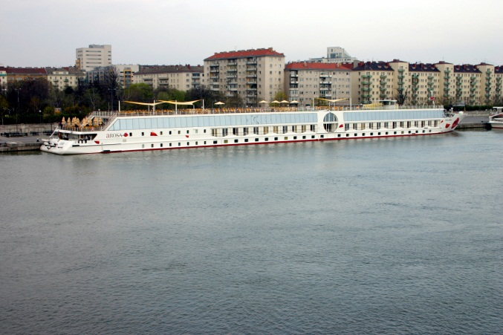
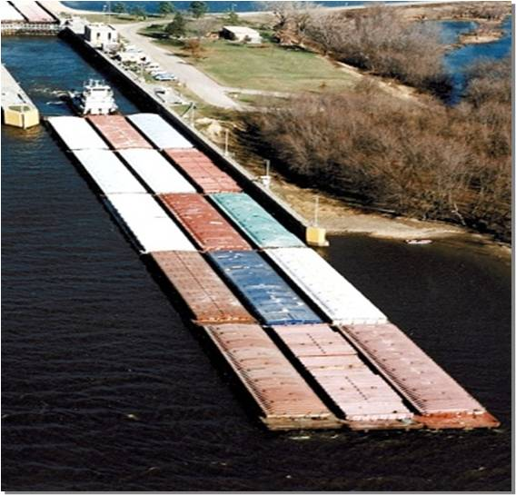
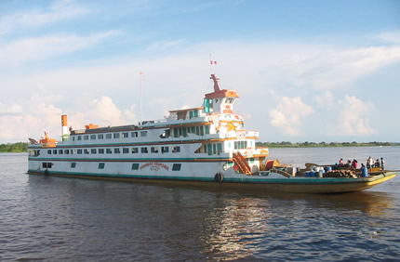
Users of Inland ENCs
There are more than 15000 users of Inland ENCs worldwide
Notes:
The next question is the number of users of Inland ENCs:
In the US …
In Russia there are more than 600 users of electronic charts on inland waterways and 58 of them have been using Inland ENCs in September 2010.
In Europe there are already more than 11 000 users of Inland ENCs (~6000 commercial navigation and ~5000 pleasure crafts).

Slide 26
Contact
Chairpersons:
Bernd Birklhuber, Austria, bernd.birklhuber@bmvit.gv.at
Denise LaDue, USA, denise.r.ladue@usace.army.mil
Jose Celso, Brazil, jose.celso@marinha.mil.br
Weijun Fei, China, fwj@wti.ac.cn
Technical coordinators:
Cameron McLeay, CARIS USA, cameron.mcleay@caris.us
Vladimir Sekachev, MORIS LLC, vladimir.sekachev@gmail.com
Nuno Silva, IIC Technologies, nuno.silva@iictechnologies.com
Gaël Billet, Persikal, g.billet@periskal.com
Yong Baek, Korea Hydrographic and Oceanographic Administration, ybaek@korea.kr
Notes:
If you need more information on Inland ENCs or the Inland ENC Harmonization Group you can contact any member of the Core Group.

Slide 27
Website: https://ienc.openecdis.org
The websites provides the Terms of Reference, list of members, minutes of meetings and all the documents of the standards for download
It provides a link to the discussion forum of IEHG
The website also provides links to international organizations, national or regional authorities, and private companies who are dealing with Inland ENCs
Notes:
And last but not least the website ienc.openecdis.org provides information on the Harmonization Group (for example the Terms of Reference, a list of the members, minutes of the meetings) and on the Inland ENC standards. All the documents can be downloaded free of charge.
The website also provides links to international organizations, national or regional authorities, and private companies who are dealing with Inland ENCs.
I hope that you have got a first overview on Inland ENCs.

Slide 28
Abbreviations
COLREG Collission Regulations of IMO
ECDIS Electronic Chart Display and Information System
ENC Electronic Navigational Chart
GLONASS Globalnaja Nawigazionnaja Sputnikowaja Sistema
IENC Inland Electronic Navigational Chart
IEHG Inland ENC Harmonization Group
IHO International Hydrographic Organization
IMO International Maritime Organization
NGIO Non Governmental International Organization
SOLAS Safety of Life at Sea Convention (IMO)

